Slide 1
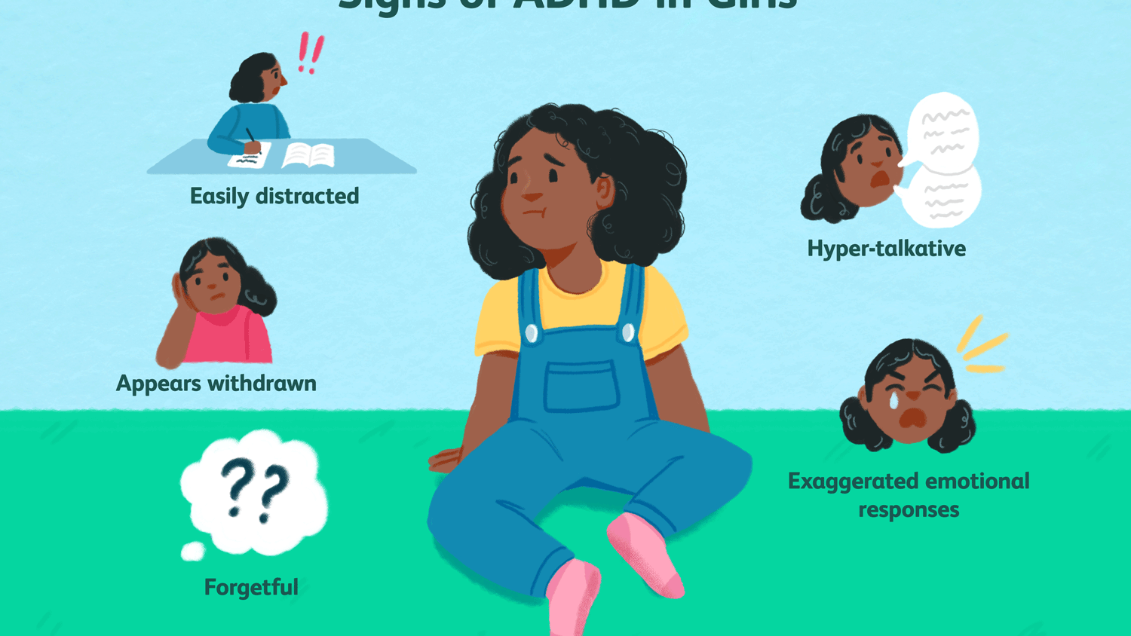
MAJOR PROJECT PRESENTATION
Brain data visualization and prediction of ADHD disease
Group 48 -
Ayush Rai
Atul Kumar
Akshat Saxena
Project Guide: Dr Anil Kumar Dubey

Slide 2
Outline
Problem statement
Motivation
Objective
Literature survey
Proposed Method
Project implementation
Results
References

Slide 3
PROBLEM INTRODUCTION Motivation
Attention deficit hyperactivity disorder is a mental disorder and after a survey it can be concluded that 5% children and 3% adults are affected by this condition.
It can cause learning disability in children which is not tolerable in this learning phase of life.
Deep analysis is required of this disease because it is one of the hardest diseases to be diagnosed.
The subtle symptoms of this disease are misunderstood most of the time. Most of the children are not properly diagnosed and always get remark by teacher that your child is not performing in class, he is not giving his best effort.
Mental disorder is illness which deteriorate the whole life of a person when neglected . ADHD is the most severe and neglected mental disease found in children and in adult .
We as a society found it very difficult and shameful to adopt the truth that he or she may be suffering from mental illness that is the main reason this kind of disease never get diagnosed and create difficulties for us in future.

Slide 4

Project Objective
Objective of the project is identification of ADHD disease by creating a machine learning model.
We will provide a technical aid to this problem by understanding brain spatial arrangement using phenotypic data , build Machine Learning Model and last attaining a decent accuracy percentage of ADHD disease prediction.

Slide 5
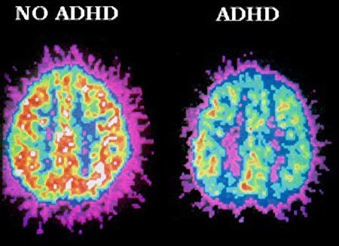
Scope of the Project
The scope of this project is to cut down on the labor time and cost required to be put down in the laboratories testing the Attention Deficit Hyperactivity disorder(ADHD) samples and thus allow the doctors to be able to treat more patients in the same amount of time and be able to detect the problem in an early stage.
With the use of machine-learning methods and techniques we aim to collaborate to the betterment of the Attention Deficit Hyperactivity disorder Detection and classifications and in turn help the people suffering from mental disorder.

Slide 6
Literature Survey
Zou, Liang, Jiannan Zheng, and Martin J. McKeown, "Deep learning based automatic diagnoses of attention deficit hyperactive disorder" in 2017 Global Conference on Signal and Information Processing (GlobalSIP).
This paper follows the method of deep learning to diagnose Attention Deficit Hyperactivity Disorder.
This paper increases the performance of CNN algorithm by taking the input dataset of three popular types of features of fMRI data.
These were combined to create a 3D dataset, which further results in 3D CNN model. As a result this model has encouraged the diagnosis accuracy of ADHD disease.
Performance of methods using classifiers like multi-kernel learning and SVM were compared to the proposed method using 3D CNN as classifier based on the ADHD–200 dataset. They found out that their proposed method gave the highest accuracy of 65.67%

Slide 7
Brown, M. R., Sidhu, G. S., Greiner, R., Asgarian, N., Bastani, M., Silverstone, P. H., ... & Dursun, S. M., “ADHD-200 Global Competition: diagnosing ADHD using personal characteristic data can outperform resting state fMRI measurements” in Frontiers in systems neuroscience, 6, 69, 2012.
In this research the researcher aims to build an intelligent model that effectively classifies the homo sapiens fMRI data into three different categories: ADHD-C, ADHD impulsive ADHD inattentive (ADHD-I) without taking much advantage of fMRI data rather using individuals personal characteristics such as intelligent level, age, gender etc.
The researchers generated the variants of fMRI data. This obtained feature set were served as input to ML classifiers which involves SVM-linear.
The training is carried out on the several different feature sets. Finally the dataset obtained is fed to the classifier to build and predict the ADHD.
The accuracy set by the researchers was 64.2% for the data used at the training time. The logistic regression classifier, linear, quadratic, cubic and kernel support vector machine performed better on all the combinations of the feature sets

Slide 8
Sidhu, G. S., Asgarian, N., Greiner, R., & Brown, M. R., “Kernel Principal Component Analysis for dimensionality reduction in fMRI-based diagnosis of ADHD” in Frontiers in systems neuroscience, 6, 74, 2012.
In this work the researchers investigated functional Magnetic Resonance Image (fMRI) scans to come up with an automated methods of diagnosis for ADHD and explored the different fMRI data to compare the diagnostic accuracy by applying various dimensionality reduction methods.
The all over model is segregated into two stages that is training and performance.
While training a model the functional MRI scans are used to build a classifier and in performance stage this classifier is used to perform the diagnosis on the test dataset.
In this model the dataset for the ADHD is divided into two components phenotypic data and imaging data. Phenotypic data includes age, sex, handedness, Intelligence level, and scanning sites of the brain whereas imaging data includes functional MRI scans.
Results for Healthy Vs ADHD class:
Only Phenotypic dataset | Only image dataset | Both
73% | 50% | 76%

Slide 9
Sen, B., Borle, N. C., Greiner, R., & Brown, M. R., “A general prediction model for the detection of ADHD and Autism using structural and functional MRI”, PloS one, 13(4), e0194856, 2018.
In this work the researches explored the naive biological ways to utilize the combinations of the structural connectivity of sMRI scans and functional features of fMRI scans to anticipate whether a person has or doesn’t have ADHD. Two types of scans used are structural MRI, and fMRI.
Structural MRI provides information on the shape, size and integrity of the brain structure.
Functional MRI measures brain activity by detecting changes associated with blood flow.
sMRI produces a volumetric representation of the brain anatomy using non-invasive technique. fMRI scans are used to measure Blood Oxygenation Level fluctuation during the brain activities.

Slide 10
Peng, X., Lin, P., Zhang, T., & Wang, J., “Extreme learning machine-based classification of ADHD using brain structural MRI data”, PloS one, 8(11), e79476, 2013.
This work proposed a method to propose an automated classification model that makes use of extreme learning algorithms efficiently to help detect the ADHD and the specific brain segment that suffers from ADHD.
In this model HD images of Magnetic Resonance images are used. The researchers collected the multiple brain measures.
The features that are to be fed as input to the SVM classifier are optimally selected .
The accuracies are as follows: -
SVM – Linear: 74.73%
SVM – RBF: 76.55%

Slide 11
Bledsoe, J. C., Xiao, D., Chaovalitwongse, A., Mehta, S., T. J., Semrud-Clikeman, M., ... & Breiger, D., “Diagnostic classification of ADHD versus control: support vector machine classification using brief neuropsychological assessment” in Journal of attention disorders, 1087054716649666, 2016.
In this paper, an attempt was to classify ADHD patients with the help of d2 test.
This is the test of attention which was carried out by taking interviews of parents of children who were grown in a complete controlled environment. Proper questionnaire for the parents was prepared accomplish this task.
Accuracies attained were as follows:
SVM for classifying children with ADHD and non ADHD– 62.3%
Decision tree for classifying children with ADHD and non ADHD -61%

Slide 12
Integrated summary of the literature studied
Most of the research works carried out earlier by the different researchers make use of the most common Global datasets available namely - ADHD-200 and ABIDE.
Both datasets include the high-definition structural MRI and functional MRI scans of both patient suffering from ADHD and healthy persons.
In some of the research works we came across the imaging dataset is combined with Phenotypic data includes age, sex, handedness, Intelligence level, and scanning sites of the brain. Phenotypic data was founded more useful in building models to detect the disorder with much greater accuracy
Various dimensionality reduction methods are used using feature selection like Sequential Forward Selection (SFS) which helps in reducing the computational cost and increase the accuracy of the model using fewer variables.

Slide 13
CONTINUED…
In order to achieve higher accuracy some images were rotated at different angles, some were blurred, and some were sharpened.
All the researches include SVM model as one of the important models to classify the healthy vs ADHD suffering patient.
In different researches different models are combined with SVM as one of the important parts to effectively produce the results. For example, CNN + SVM (linear/kernel).
The average accuracy rate is 68%.

Slide 14
Proposed Method
We will work on parameters namely variations in Physical factors such as age, IQ level etc., and thus will collect the required dataset.
After collecting the dataset our first aim is to successfully clean the dataset and preprocess it. Then we will perform the correlation analysis to collect the knowledge of the degree of correlation among parameter
Now, at this point of time we will divide the dataset into two parts ‘train’ and ‘test’ in the ratio of 70:30 and rest all operation except testing will be done on training dataset.
We will scale the data so that our model does not over fit or under fit .
The last step is to train and classify the different models and compare their results on the parameter of accuracy and time taken.

Slide 15
Basic Workflow:
Collection of Dataset
Read Dataset
Pre process
Divide into train and test data
Scale and Transform data
Build and Fit the Model

Slide 16
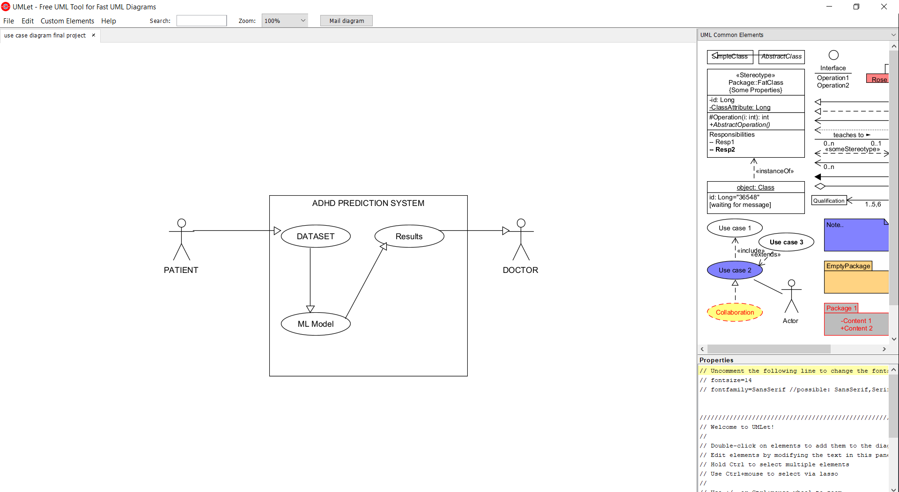
Collection of Dataset
Read Dataset
Pre process
Divide into train and test data
Train model
Test model
FLOW CHART FOR MACHINE LEARNING MODEL
USE CASE DIAGRAM

Slide 17
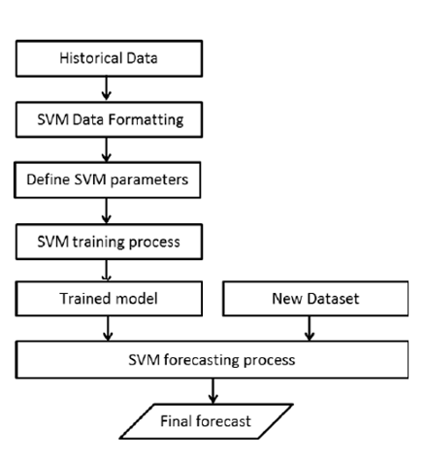
Start
Select training set
Performance Evaluation
Select test set
Output Optimal Parameters
Get classification (SVM)Model
Ending
Predict Test Set
SVM Model Implementation Flowchart

Slide 18
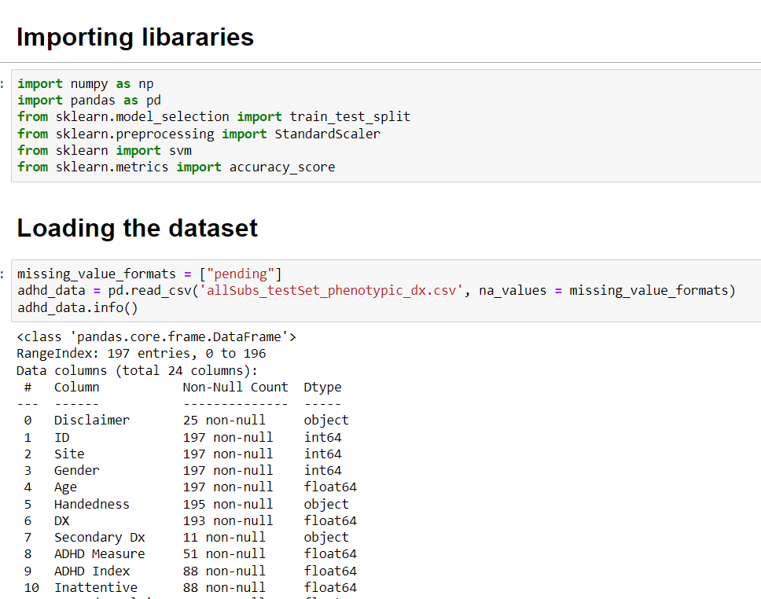
Implementation and Results

Slide 19
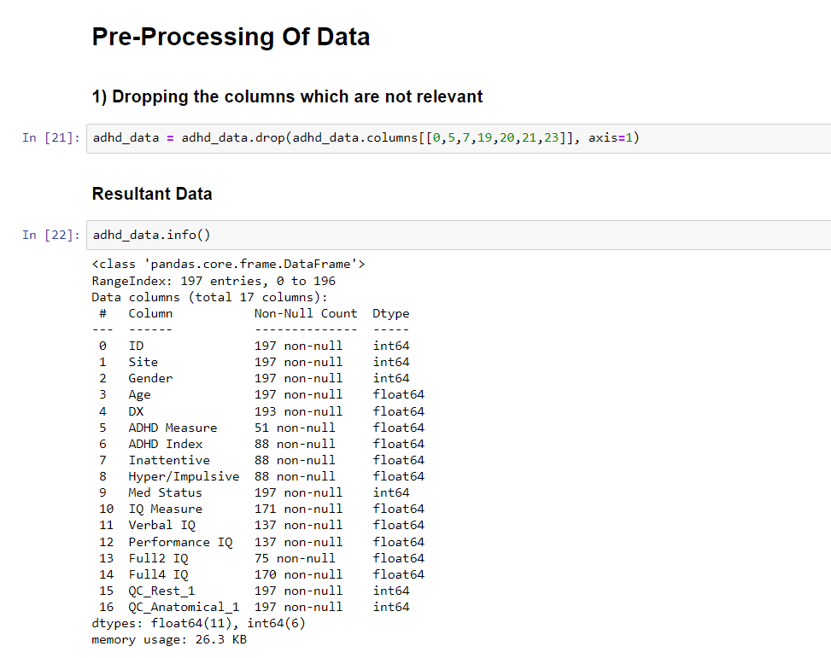

Slide 20
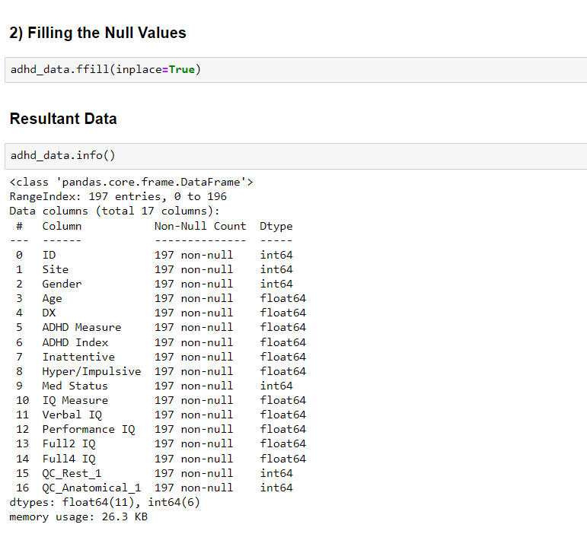

Slide 21
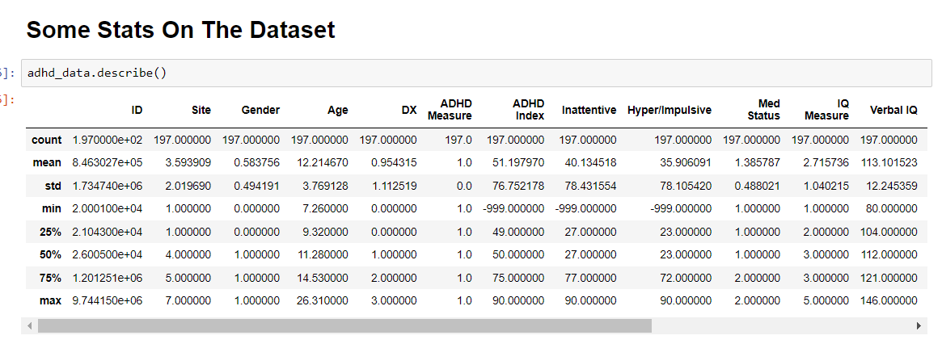
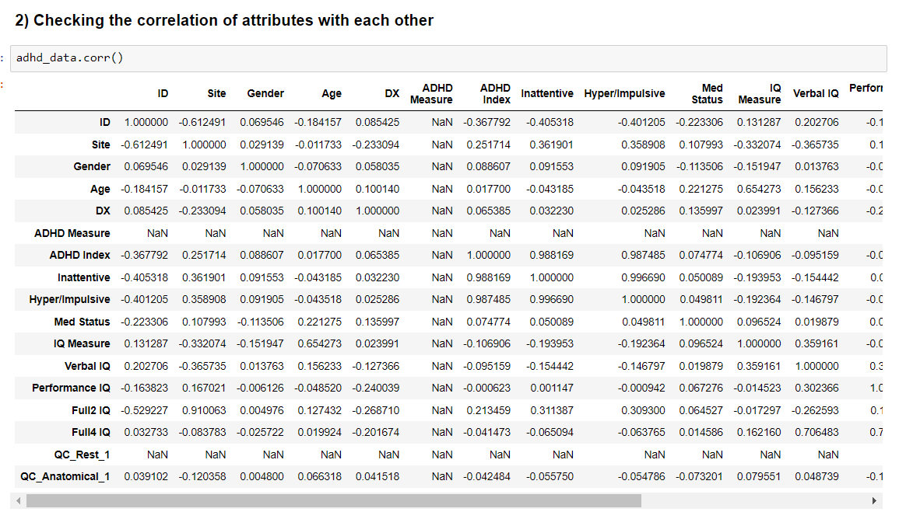

Slide 22
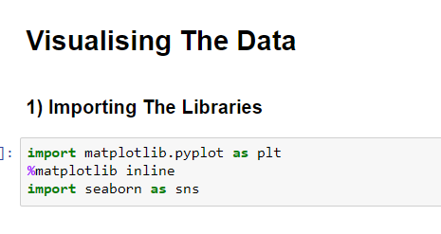
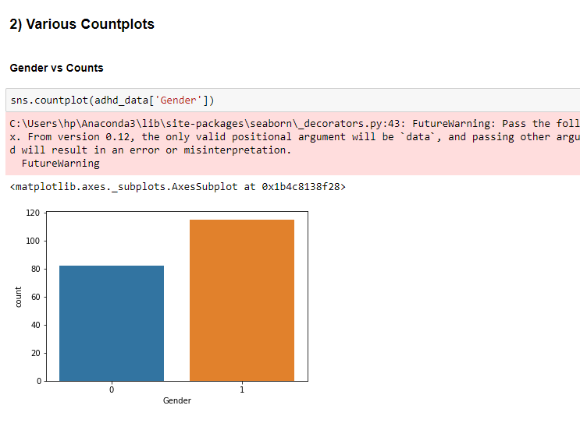
0 is for male
1 is for female

Slide 23
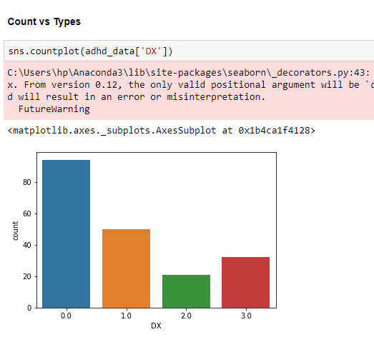
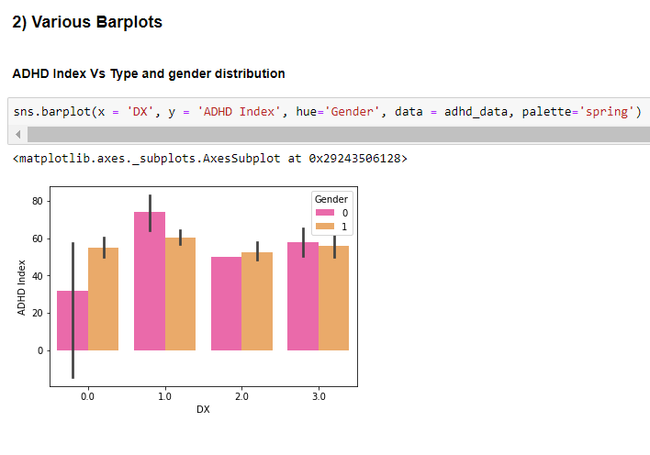

Slide 24
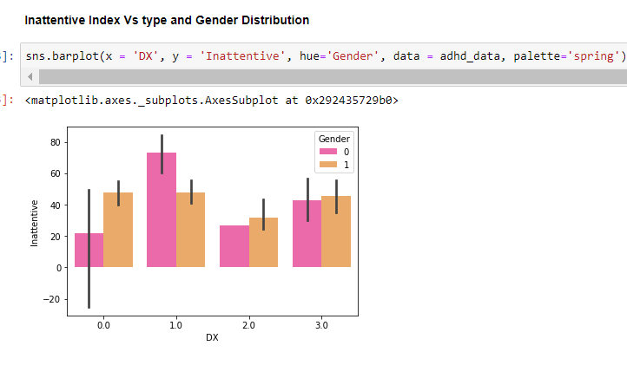

Slide 25
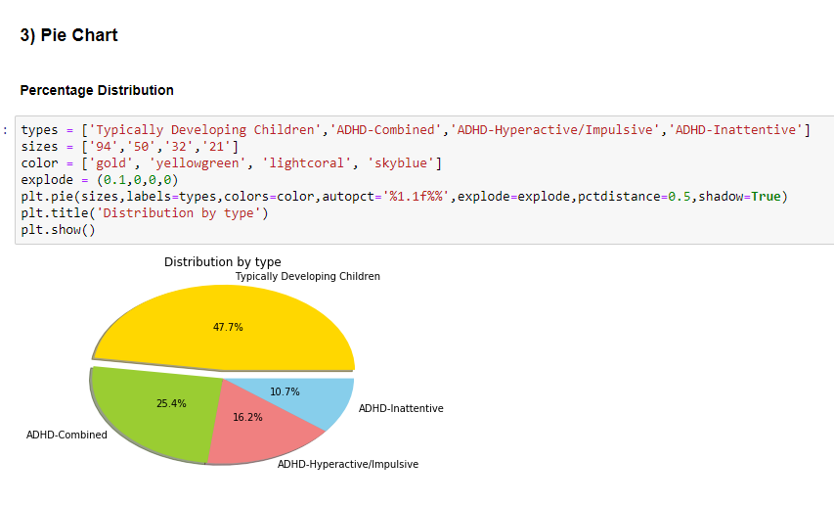

Slide 26

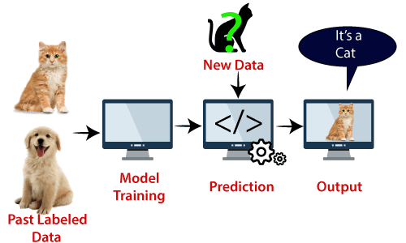
SUPPORT VECTOR MACHINE
SVM is one of the most popular Supervised Learning algorithms, which is used for Classification as well as Regression problems.
However, primarily, it is used for Classification problems in Machine Learning.
The goal of the SVM algorithm is to create the best line or decision boundary that can segregate n-dimensional space into classes so that we can easily put the new data point in the correct category in the future. This best decision boundary is called a hyperplane.

Slide 27
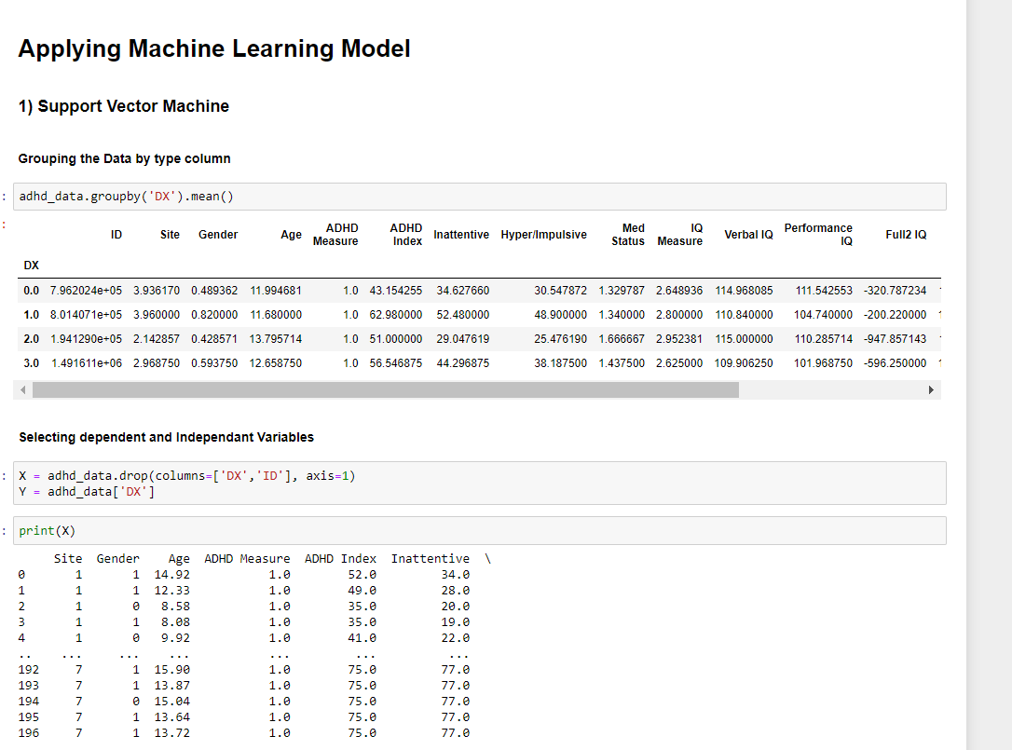

Slide 28
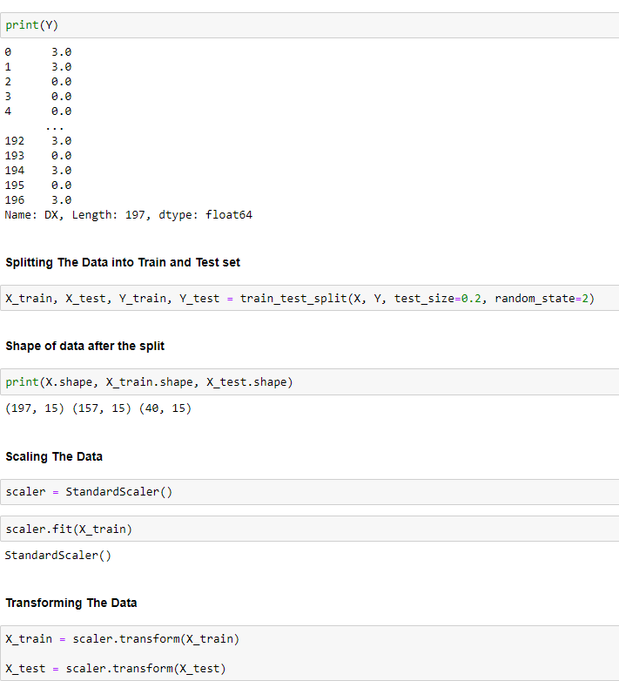

Slide 29
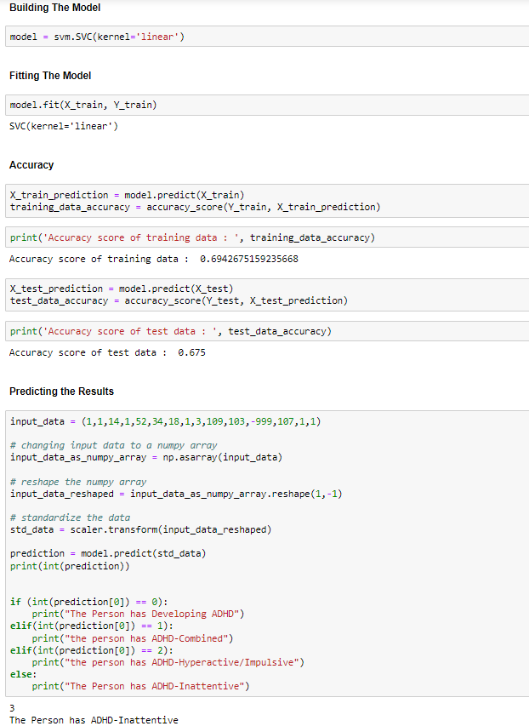

Slide 30

DECISION TREE
It is a Supervised learning technique that can be used for both classification and Regression problems, but mostly it is preferred for solving Classification problems.
It is a tree-structured classifier, where internal nodes represent the features of a dataset, branches represent the decision rules and each leaf node represents the outcome.
The decisions or the test are performed on the basis of features of the given dataset.
In a Decision tree, there are two nodes, which are the Decision Node and Leaf Node.
Decision nodes are used to make any decision and have multiple branches, whereas Leaf nodes are the output of those decisions and do not contain any further branches.

Slide 31
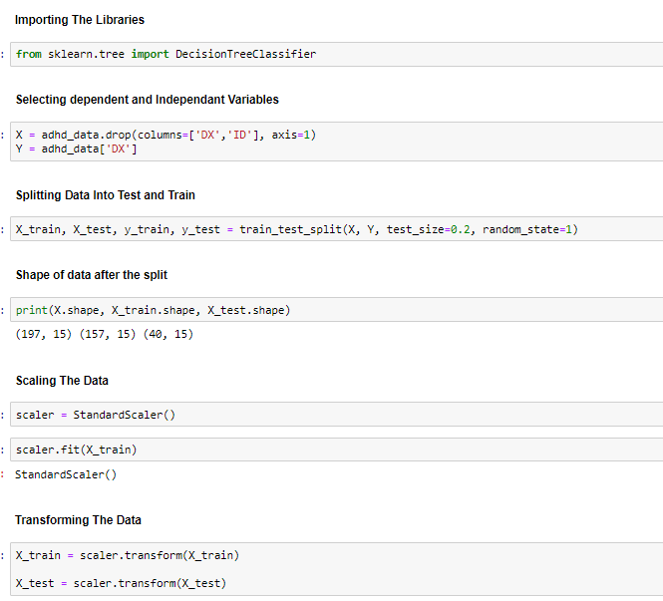
DECISION TREE ALGORITHM

Slide 32
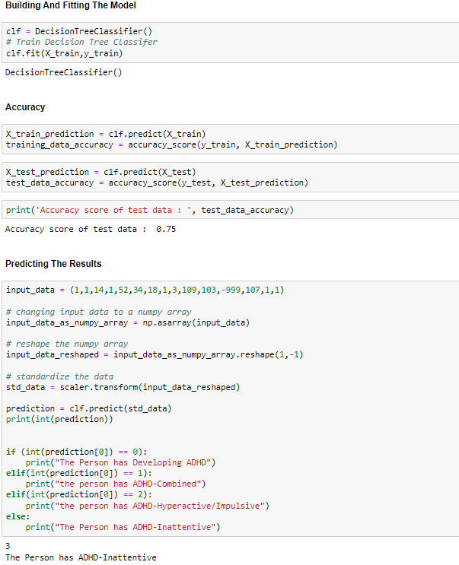

Slide 33
LOGISTIC REGRESSOR CLASSIFIER
Logistic regression is a supervised learning classification algorithm used to predict the probability of a target variable. The nature of target or dependent variable is dichotomous, which means there would be only two possible classes.
In simple words, the dependent variable is binary in nature having data coded as either 1 (stands for success/yes) or 0 (stands for failure/no).
Mathematically, a logistic regression model predicts P(Y=1) as a function of X. It is one of the simplest ML algorithms that can be used for various classification problems such as spam detection, Diabetes prediction, cancer detection etc.

Slide 34
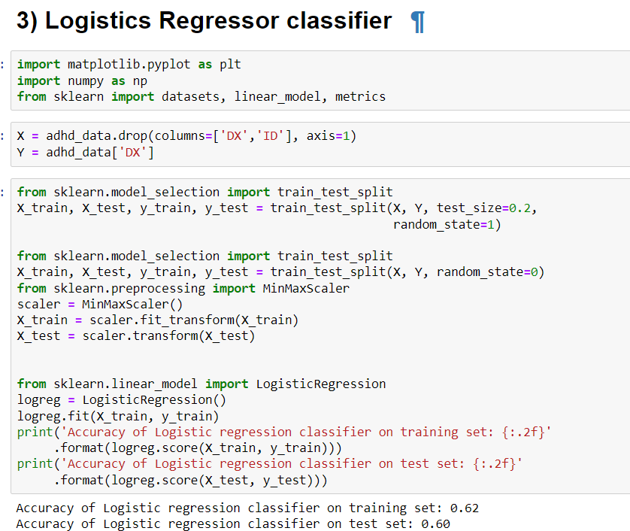
Logistic regressor classifier

Slide 35
KNN CLASSIFIER
K-NN algorithm assumes the similarity between the new case/data and available cases and put the new case into the category that is most similar to the available categories.
K-NN algorithm stores all the available data and classifies a new data point based on the similarity. This means when new data appears then it can be easily classified into a well suite category by using K- NN algorithm.
It is also called a lazy learner algorithm because it does not learn from the training set immediately instead it stores the dataset and at the time of classification, it performs an action on the dataset

Slide 36
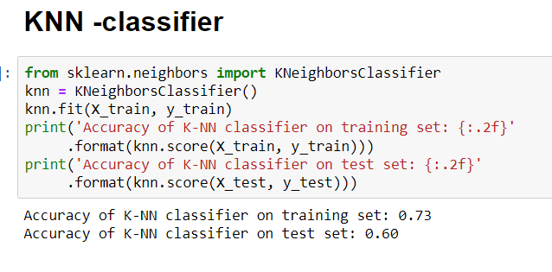
KNN CLASSIFIER OUTPUT

Slide 37
Linear Discriminant Analysis
Linear Discriminant Analysis or Normal Discriminant Analysis or Discriminant Function Analysis is a dimensionality reduction technique that is commonly used for supervised classification problems. It is used for modelling differences in groups i.e. separating two or more classes.
It is used to project the features in higher dimension space into a lower dimension space.
For example, we have two classes and we need to separate them efficiently. Classes can have multiple features. Using only a single feature to classify them may result in some overlapping. So, we will keep on increasing the number of features for proper classification

Slide 38
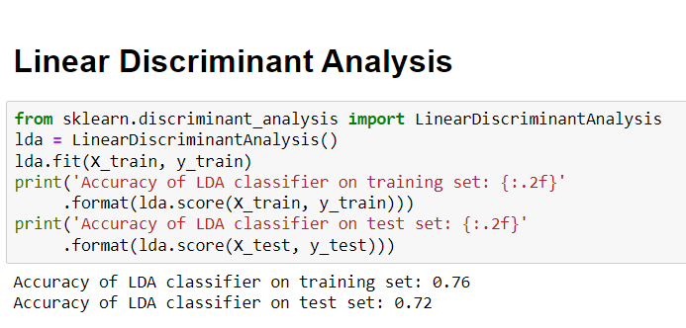
LINEAR DISCRIMINANT ANALYSIS (LDA)

Slide 39
Naïve Bayes Algorithm
Naïve Bayes algorithm is a supervised learning algorithm, which is based on Bayes theorem and used for solving classification problems.
It is mainly used in text classification that includes a high-dimensional training dataset.
Naïve Bayes Classifier is one of the simple and most effective Classification algorithms which helps in building the fast machine learning models that can make quick predictions.
It is a probabilistic classifier, which means it predicts on the basis of the probability of an object.

Slide 40
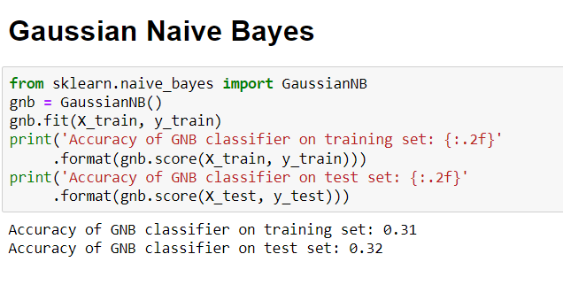
Gaussian Naïve Bayes

Slide 41
COMPARATIVE ANALYSIS OF VARIOUS MACHINE LEARING MODEL USED
MODEL | ACCURACY
Support Vector Machine | 69 %
Decision Tree Algorithm | 50 %
Logistic Regressor Classifier | 60 %
KNN Classifier | 60 %
Linear Discriminant Analysis | 67 %
Naïve Bayes Algorithm | 32 %

Slide 42
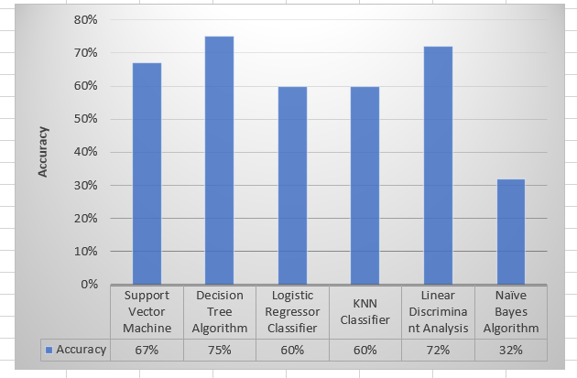
Graphical Comparison of Accuracy

Slide 43
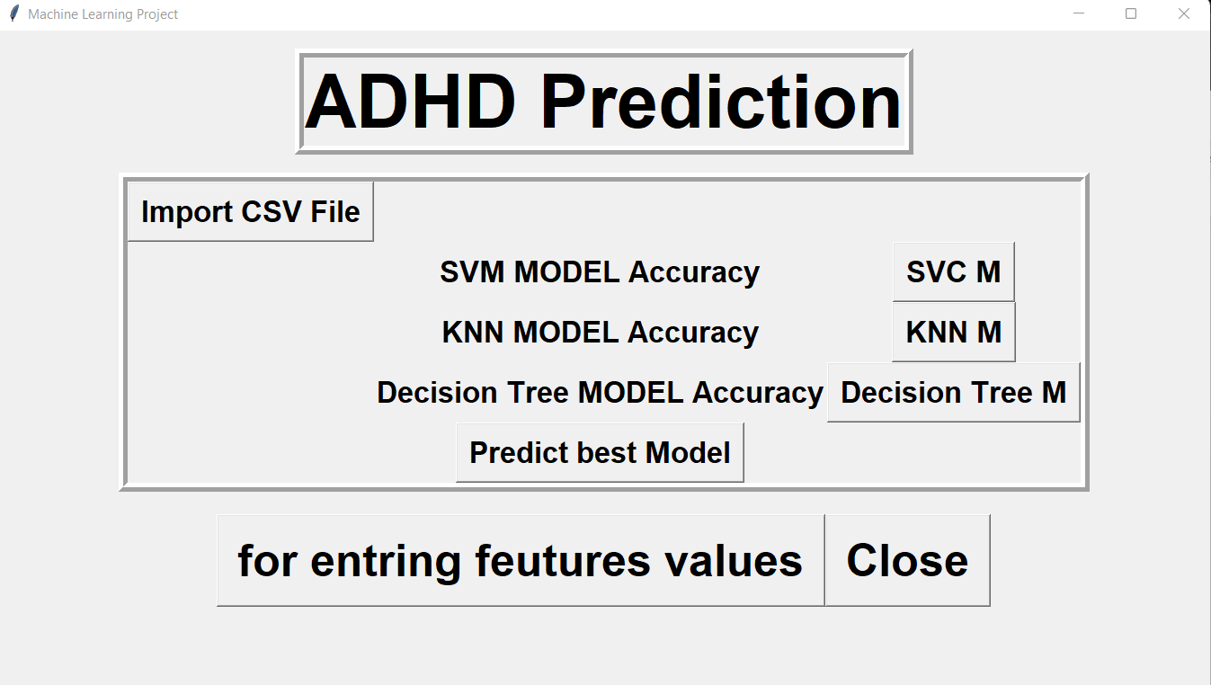
GRAPHICAL USER INTERFACE

Slide 44
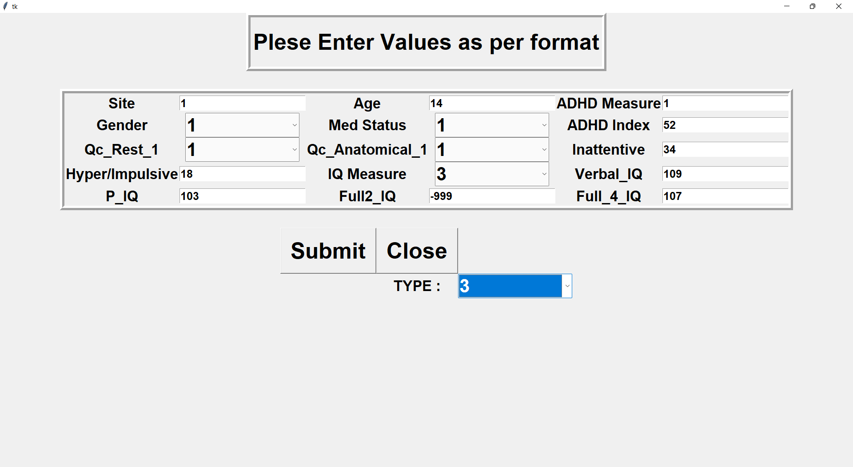

Slide 45
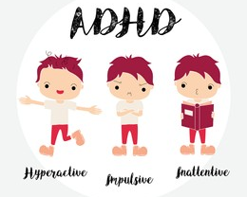

Stakeholders
This project will be extremely helpful in prediction of ADHD in early stages among children and adults suffering from this mental illness. Also it will reduce the burden of hospital in conducting these tests and generating the report as our model will provide the same result or even better.
Referred to Doctor through the prediction system

Slide 47
 | MONTH |  | Feb |  |  |  |  | March |  |  |  |  | April |  |  |  |  | May
Week |  |  | 1 | 2 | 3 | 4 | 5 | 1 | 2 | 3 | 4 | 5 | 1 | 2 | 3 | 4 | 5 | 1 | 2 | 3 | 4 | 5
Implementation of code and Testing
Error and Exception handling
Documentation
Risk Analysis
Findings, Checking for further Development
Final Deployment and Submission

Slide 48
REFERENCES
Jensen, P. S., Martin, D., & Cantwell, D. P., “Comorbidity in ADHD: implications for research, practice, and DSM-V” in Journal of the American Academy of Child & Adolescent Psychiatry, pp. 1065-1079, 1997.
Singh, I., “Biology in Context: Social and Cultural Perspectives on ADHD. Research Review” in Children & society, pp. 360-67, 2002.
Sinha, A., Pratik, R., & Panchal, M., “MRI IMAGE SEGMENTATION–A REVIEW”, 2014.
Miao, Bo, and Yulin Zhang, "A feature selection method for classification of ADHD" 4th International Conference on Information, Cybernetics and Computational Social Systems (ICCSS). IEEE 2017.
Miao, B., Zhang, L. L., Guan, J. L., Meng, Q. F. & Zhang, Y. L. “Classification of ADHD Individuals and Neurotypicals Using Reliable RELIEF: A Resting-State Study” IEEE Access, 7, pp. 62163-62171, 2019.
Kaur, S., Singh, S., Arun, P., Kaur, D., & Bajaj, M., “Phase Space Reconstruction of EEG Signals for Classification of ADHD and Control Adults”, in Clinical EEG and Neuroscience, 51(2), pp. 102-113, 2020.
Wang, Z., Sun, Y., Shen, Q., & Cao, L., “Dilated 3D Convolutional Neural Networks for Brain MRI Data Classification” IEEE Access, 7, pp. 134388-134398, 2019.

Slide 49
Wang, Tianyi, and Sei-ichiro Kamata. "Classification of Structural MRI Images in Adhd Using 3D Fractal Dimension Complexity Map." 2019 IEEE International Conference on Image Processing (ICIP). IEEE.
Alchalabi, A. E., Shirmohammadi, S., Eddin, A. N., & Elsharnouby, M., “FOCUS: detecting ADHD patients by an EEG-based serious game”, in IEEE Transactions on Instrumentation and Measurement, 67(7), pp. 1512-1520, 2018.
Kaur, S., Arun, P., Singh, S., & Kaur, D., “EEG Based Decision Support System to Diagnose Adults with ADHD” in 2018 IEEE Applied Signal Processing Conference (ASPCON), pp. 87-91, IEEE.
Bledsoe, J. C., Xiao, D., Chaovalitwongse, A., Mehta, S., Grabowski, T. J., Semrud-Clikeman, M., ... & Breiger, D., “Diagnostic classification of ADHD versus control: support vector machine classification using brief neuropsychological assessment” in Journal of attention disorders, 1087054716649666, 2016.
www.cdc.gov for learning about ADHD, its types, symptoms , diagnosis etc(last accessed time 10:30 pm 26-11-2021)
www.ieeexplore.ieee.org
Javatpoint Machine Learning tutorial (last accessed time 10:30 pm 26-11-2021)
GeeksForGeeks tutorials on machine learning (last accessed time 10:30 pm 26-11-2021

Slide 50


THANK YOU

